Slide 1
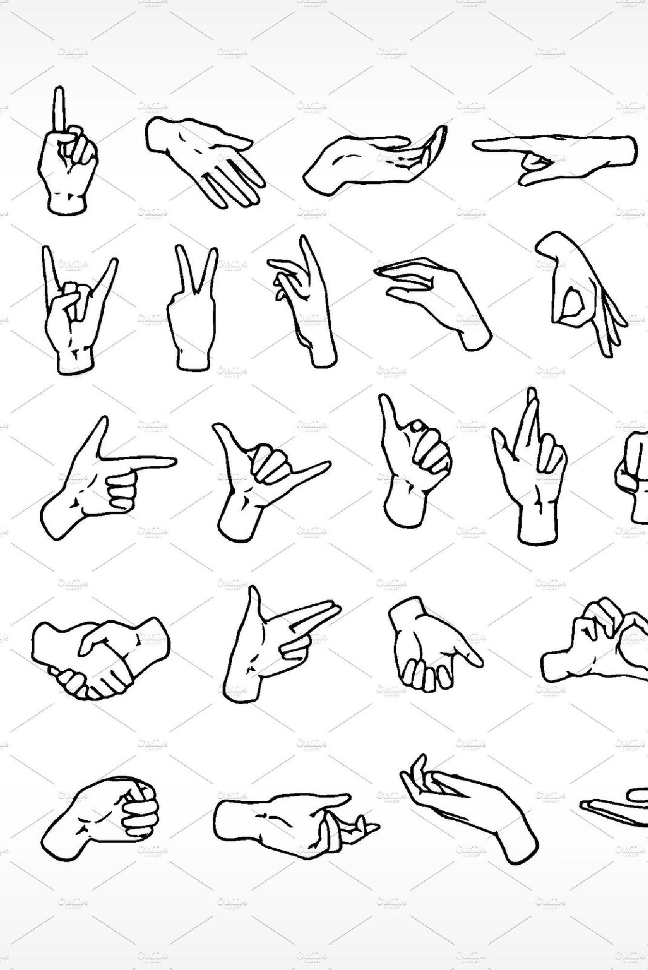


Hand Gesture Volume and Brightness Control
Learn about a revolutionary new way to control your devices using hand gestures! Say goodbye to clunky remote controls and hello to a more intuitive and natural way of interacting with your technology.
by Shailesh

Slide 2

Abstract
What is Hand Gesture Control?
Hand gesture control is a technology that allows users to interact with devices using simple hand gestures instead of buttons or remotes.
Why is it Important?
Hand gesture control is important because it offers a more intuitive and natural way of interacting with devices, which can make tasks easier and more enjoyable.
How Does it Work?
Hand gesture control works by using cameras and sensors to detect users' hand movements and translate them into commands for the device.
Who Benefits from Hand Gesture Control?
Hand gesture control can benefit everyone, but it's especially useful for people with disabilities or mobility issues.

Slide 3

Introduction
1
History of Hand Gesture Control
The first hand gesture control system was invented in the 1980s, but it wasn't until recently that the technology became advanced enough to be practical for everyday use.
Applications of Hand Gesture Control
2
Hand gesture control can be used in a wide variety of applications, from controlling home entertainment systems to piloting drones.
3
Current Challenges
One of the biggest challenges facing hand gesture control systems is the need for precise and reliable detection of hand movements, especially in low-light environments.

Slide 4



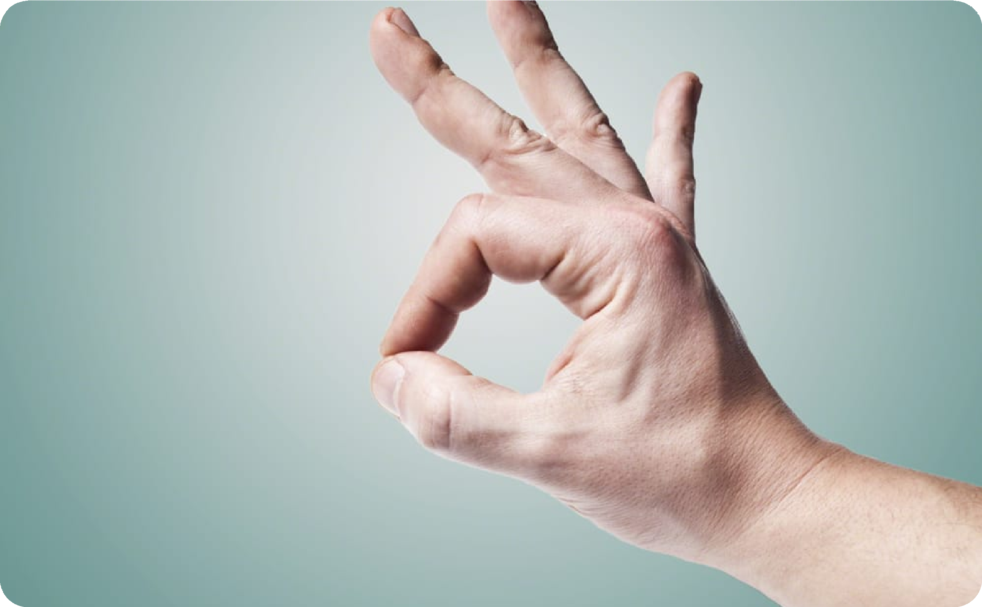

Motivation
Frustrating User Experiences
Inaccessible Technology
Natural Interaction
Hand gesture control offers a more natural and intuitive way of interacting with technology, which can make tasks easier and more enjoyable.
Many people find traditional remote controls and button- based interfaces to be frustrating and unintuitive.
Many people with disabilities or mobility issues find traditional interfaces to be inaccessible or difficult to use.
Fun and Engaging
Hand gesture control is often more fun and engaging than traditional interfaces, which can make using technology a more enjoyable experience.

Slide 5


Innovation Idea of the Project
1
Revolutionary Technology
Hand gesture control is a cutting-edge technology that is poised to revolutionize the way we interact with our devices.
2
User-Focused Design
Our hand gesture control system is designed with users in mind, offering a more intuitive and natural way of interacting with technology.
3
Advanced Algorithms
Our system uses advanced algorithms to detect hand movements with high precision and accuracy, even in low- light environments.
4
Limitless Potential
The potential applications of hand gesture control are endless, from home entertainment to industrial automation.

Slide 6
Scope
Home Entertainment
Control your TV, stereo, and other home entertainment devices with simple hand gestures.
Virtual Reality
Navigate virtual reality environments with natural and intuitive hand gestures.
Industrial Automation
Control robots and other industrial equipment with hand gestures, improving safety and efficiency.

Slide 7

Hand Gesture Volume Control
Intuitive Feedback
Our system provides intuitive feedback, such as visual cues or haptic feedback, to let you know that your gestures have been detected.
1
2
3
Simple Gestures
Adaptive Algorithms
Adjust the volume of your device using simple hand gestures, such as swiping up or down.
Our system uses adaptive algorithms that adjust to the unique characteristics of each user's gestures, improving detection accuracy over time.

Slide 8

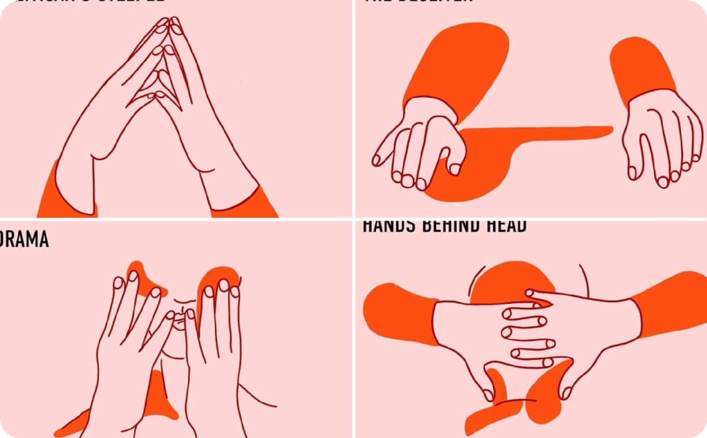
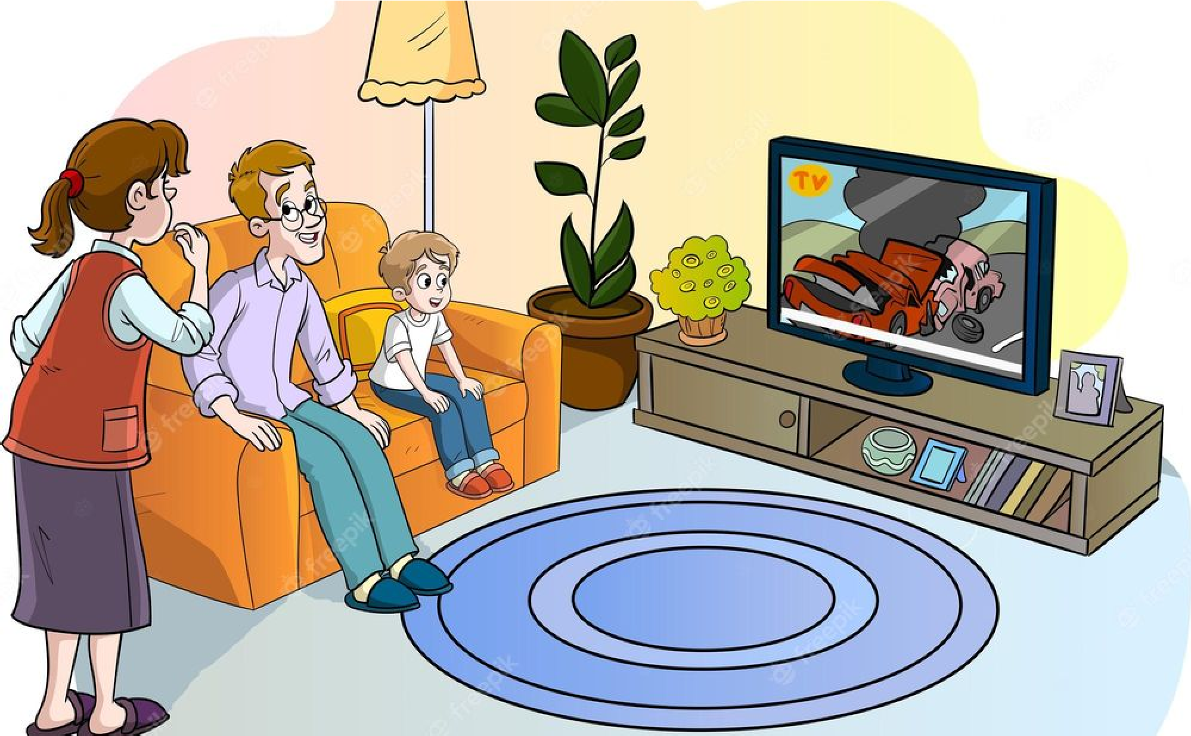
Hand Gesture Brightness Control
Simple and Convenient
Precise and Accurate
Fun and Engaging
Adjust the brightness of your device with simple and convenient hand gestures, such as waving your hand.
Our system uses advanced algorithms to detect hand gestures with high precision and accuracy, ensuring that your commands are always executed correctly.
Brightness control isn't just a utility - it can also be a fun and engaging way to interact with your devices.

